Slide 1
Customer Segmentation: Use Machine Learning to segment customer based on their financial behaviour and demographics to improve targeted marketing effort

Slide 2
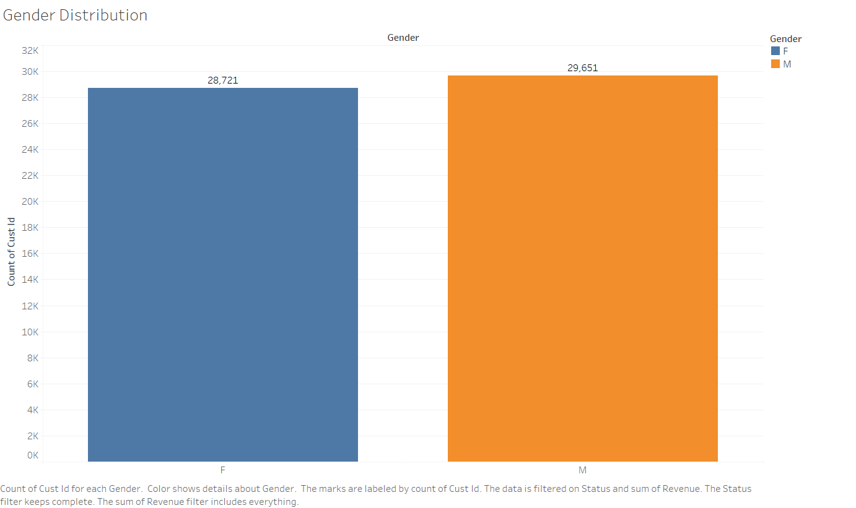

Slide 3
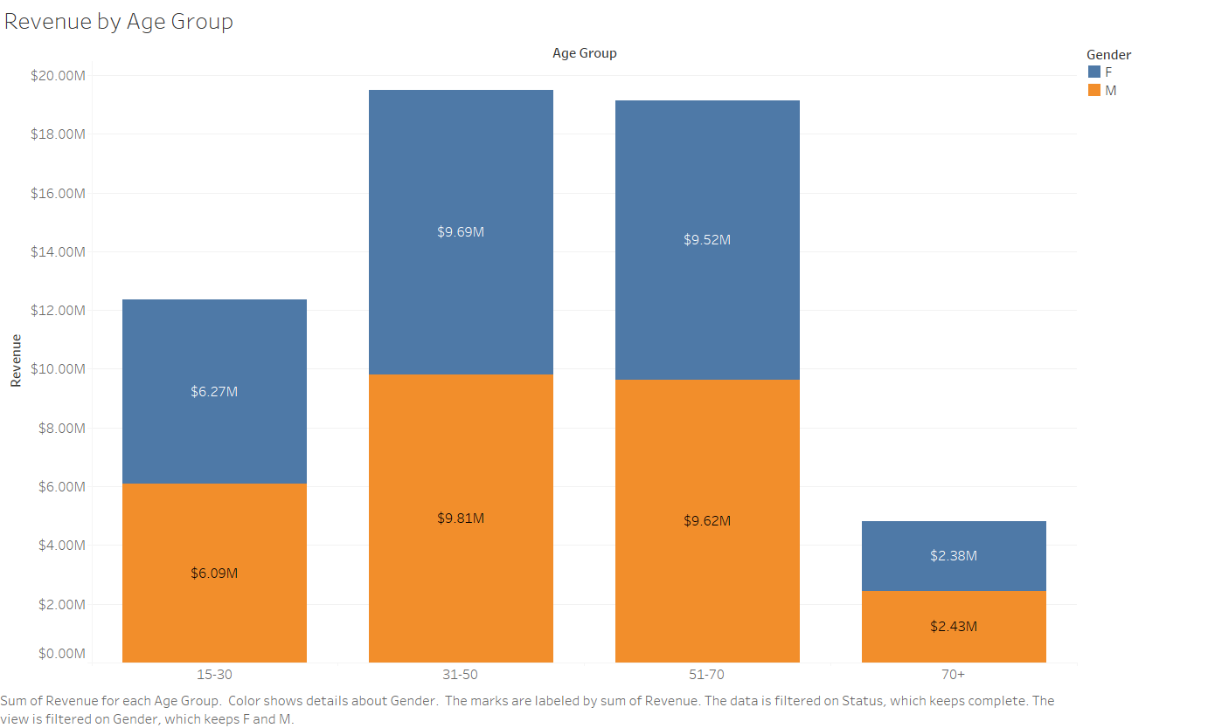

Slide 4
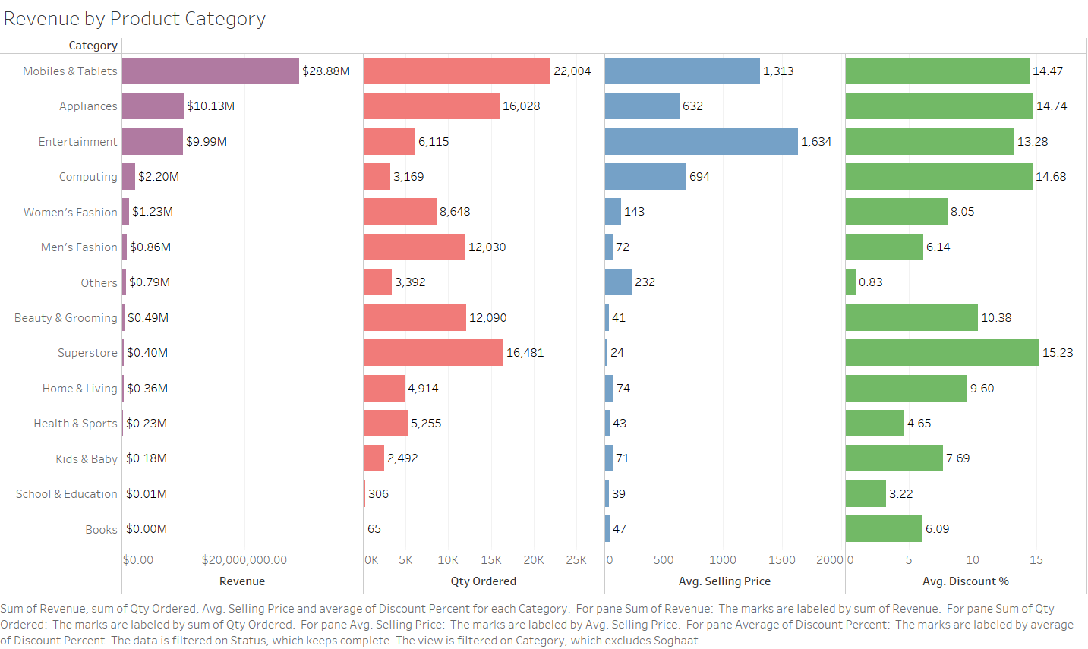

Slide 5
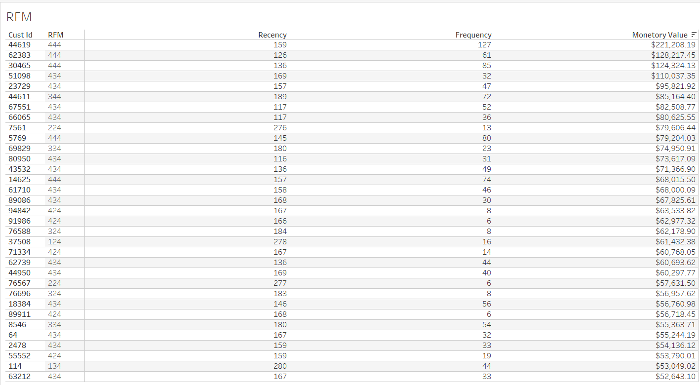

Slide 6
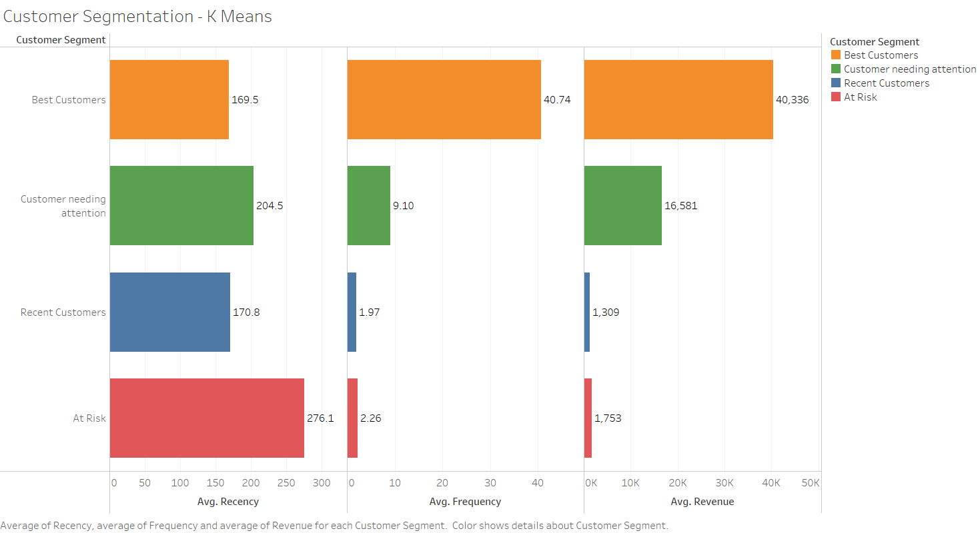

Slide 7
